Slide 1
Algebraic Fractions
EQ – How do we add and subtract algebraic fractions with a binomial in the numerator?
Year 10

Slide 2
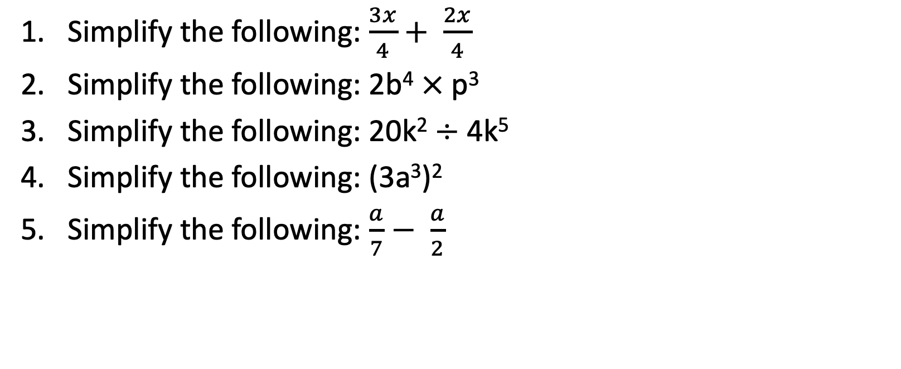
Five Questions (LHS)
Topic: Algebraic Fractions
EQ – How do we add and subtract algebraic fractions with binomial in the numerator?
Simplify the following: $\frac{3x}{4}+ \frac{2x}{4}$
Simplify the following: 2b⁴ $×$p³
Simplify the following: 20k² $÷$ 4k⁵
Simplify the following: (3a³)²
Simplify the following: $\frac{a}{7}− \frac{a}{2}$

Slide 3

Learning Intentions
Students will be able to
Define the steps taken to get a Lowest Common Denominator (LCD)
Apply LCD to algebraic fractions with binomial numerators
Add and subtract algebraic fractions with different denominators and binomial numerators
WICOR

Slide 4
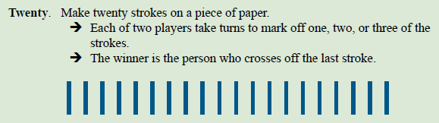
But first, a game
Notice any patterns?

Slide 5
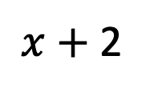


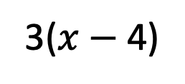
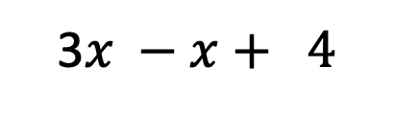

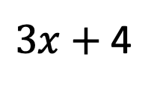
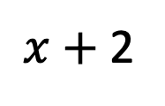




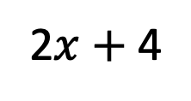

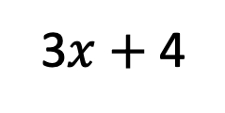

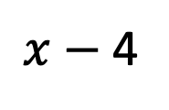






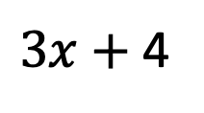


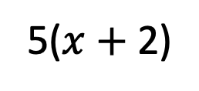



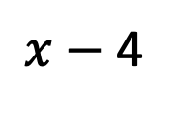


24
7
30
Algebraic Fractions
Date:
EQ – How do we add and subtract algebraic fractions with a binomial in the numerator?
Remember: Denominators need to be the same. Then we apply algebra to the numerator
Simplify these algebraic expressions:
$x$ $+$ 2
$x$ $−$ 4
Solution
$−$
$3x$ $+$ 4
$$x$$
3
5
Solution
$−$
7
7
$x$ $+$ 2
$x$ $−$ 4
$−$
$=$
$−$
3$x$ $+$ 4
$$x$$
3
5
15
15
$3x$ $+$ 4
$$x$$
$−$
$−$
$=$
7
7
7
Find a common denominator.
5($x$ $+$ 2)
$−$
3($x$ $−$ 4)
$=$
Is the denominator common?
3$x −x+ 4$
15
$=$
Write as a single fraction.
7
5$x$ $+$ 10 $−$ 3$x$ $+$ 12
$=$
If yes, then write as a single fraction.
15
Expand and keep a close focus no the negative signs.
2$x$ $+$ 4
$=$
7
2$x$ $+$ 22
Collect like terms is possible.
Collect like terms is possible.
$=$
15

Slide 6

Do you understand? Fists of Five
Notes:
Check for Understanding

Slide 7
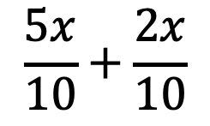
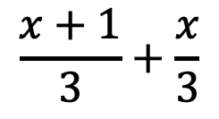
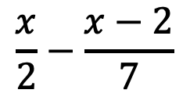
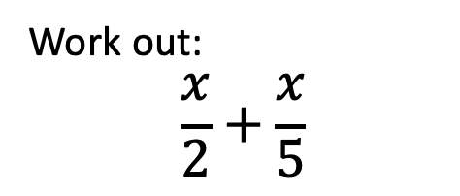


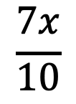
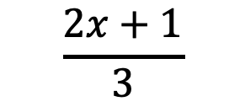

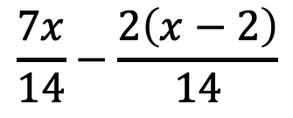
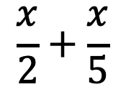

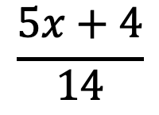
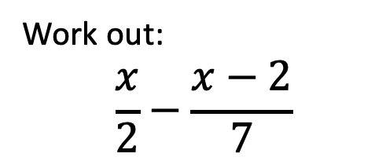
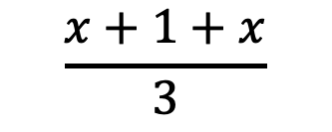

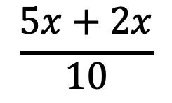

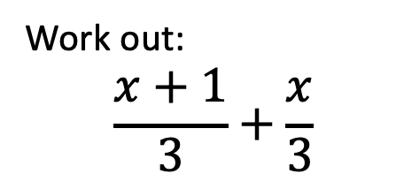


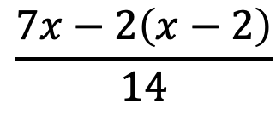
24
7
30
Algebraic Fractions
Date:
EQ – How do we add and subtract algebraic fractions with a binomial in the numerator?
Let’s try these together
Ex1
Ex2
Ex3
Work out:
$$\frac{x}{2}+\frac{x}{5}$$
Work out:
$$\frac{x+1}{3}+\frac{x}{3}$$
Work out:
$$\frac{x}{2}−\frac{x−2}{7}$$
Solution
Solution
Solution
$$\frac{x}{2}+\frac{x}{5}$$
$$\frac{5x}{10}+\frac{2x}{10}$$
$$\frac{x+1}{3}+\frac{x}{3}$$
$$\frac{x+1+x}{3}$$
$$\frac{x}{2}−\frac{x−2}{7}$$
$$\frac{7x}{14}−\frac{2\left(x−2\right)}{14}$$
$$=$$
$$=$$
$$=$$
$$\frac{5x+2x}{10}$$
$$\frac{2x+1}{3}$$
$$\frac{7x−2\left(x−2\right)}{14}$$
$$=$$
$$=$$
$$=$$
$$\frac{7x}{10}$$
$$\frac{5x+4}{14}$$
$$=$$
$$=$$

Slide 8
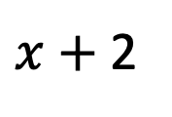

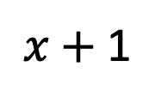

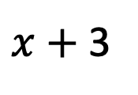
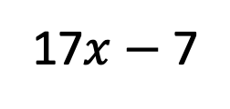
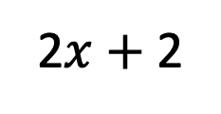
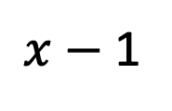

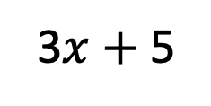
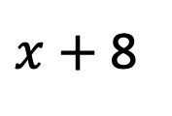
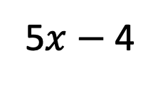







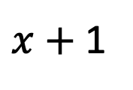
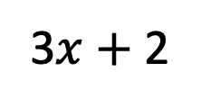
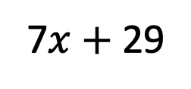
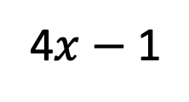
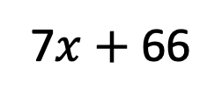
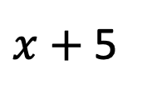
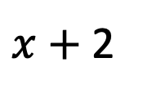


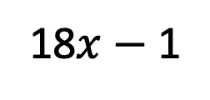

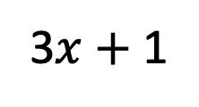
Your Turn - Write the following as a single fraction in its simplest form. Use the steps from the previous examples
$x$ $+$ 2
$x$
2$x$ $+$ 2
$x$ $+$ 1
$x$ $+$ 2
$x$
[a]
$+$
$=$
[e]
$−$
$=$
Solution
3
3
3
2
4
4
$x$ $+$ 5
2$x$
3$x$ $+$ 5
$x$ $+$ 8
$x$ $+$ 3
7$x$ $+$ 66
[b]
$+$
$=$
[f]
$−$
$=$
4
4
4
2
9
18
$x$ $+$ 5
$x$ $+$ 2
7$x$ $+$ 29
3$x$ $+$ 2
5$x$ $−$ 4
17$x$ $−$ 7
[c]
$+$
$=$
[g]
$+$
$=$
2
5
10
10
6
15
$x$ $+$ 1
$x$ $−$ 1
13 $+$ $x$
3$x$ $+$ 1
4$x$ $−$ 1
18$x$ $−$ 1
[d]
$−$
$=$
[h]
$+$
$=$
6
7
42
6
4
12

Slide 9
Notes Review
24, 7 ,30
Date
Title
Essential question
Notes complete
Notes complete with colour and diagrams
Questions completed
Contents page filled in
Formula page filled in

Slide 10
Homework
Review your notes, finish any unanswered questions and write a summary answering the Essential Question.

